Slide 1
Build Your Agent Using Microsoft Copilot Studio

Slide 2
Microsoft Copilot Studio Hands-on workshop

Slide 3
Agenda
Introduction to Microsoft Copilot Studio
Lab 1: Create your first copilot in Microsoft Copilot Studio
Lab 2: Authoring 101
Lab 3: Knowledge sources, AI knowledge, and custom instructions
Lab 4: Build and Invoke Power Automate cloud flows
Lab 5: Invoke AI Builder prompts
Lab 6: Make HTTP requests to connect to an API
Lab 7: Use generative AI orchestration to interact with your connectors
Lab 8: Using topic inputs
Q&A

Slide 4
Agenda
Coffee – 8am till 10am
Lunch break – 11:30am

Slide 5
Introduction to Copilot Studio

Slide 6
What is an agent?
An experience using generative AI to assist humans with
complex cognitive tasks.
Chat using natural language (and code)
You determine, guide, and approve the output
Its value increases with complexity
Notes:
Dewain
We get this question all the time: What exactly is Copilot?
Our definition – a copilot is an AI-driven partner that is guided by an individual or an organization to help amplify creativity and accelerate results.
The more complex the task, the greater the value that Copilot delivers.

Slide 7
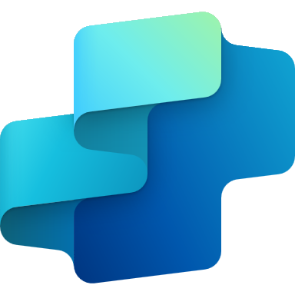

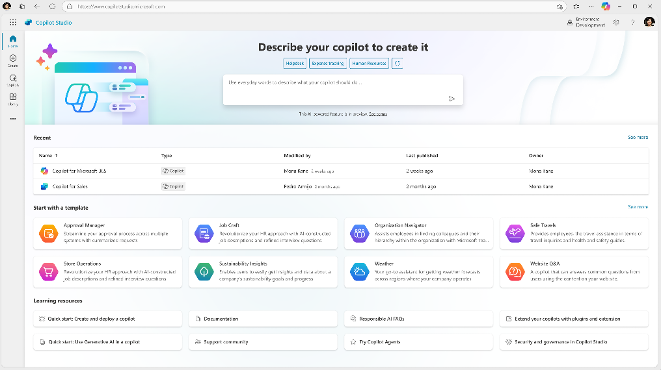
Announcement slide (dark) with color rotation
Microsoft Copilot Studio
Your agent, your way
Copilot Studio is an end-to-end conversational AI product for
building your own agent or extending Microsoft Copilot with generative AI, large language models and your data.
Notes:
Dewain

Slide 8



Different building journeys for different needs
Copilot Studio
Included in Copilot for M365
Standalone
Azure AI Studio
Customize Microsoft Copilot
Build your own custom copilots
Connect with your data sources outside of Copilots reach
Build customer or internal facing copilots with your data and workflows, on channels that work for you
Call your redesigned business processes and workflows
Rules-based dialog management and conversational orchestration with a prebuilt LLM
Configure LLMs with prompt engineering
Configure Copilot responses to specific questions
Managed SaaS, no infrastructure, built in security and governance
Manage own infrastructure, custom dev and security
Building Copilot Extensions
Build Conversational Orchestration
Build Models
Extend Copilot Studio with Azure AI Studio

Slide 9
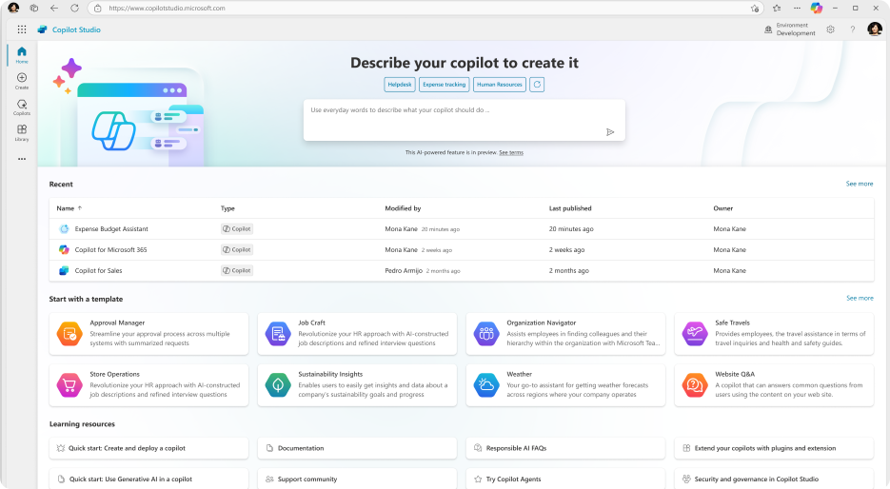
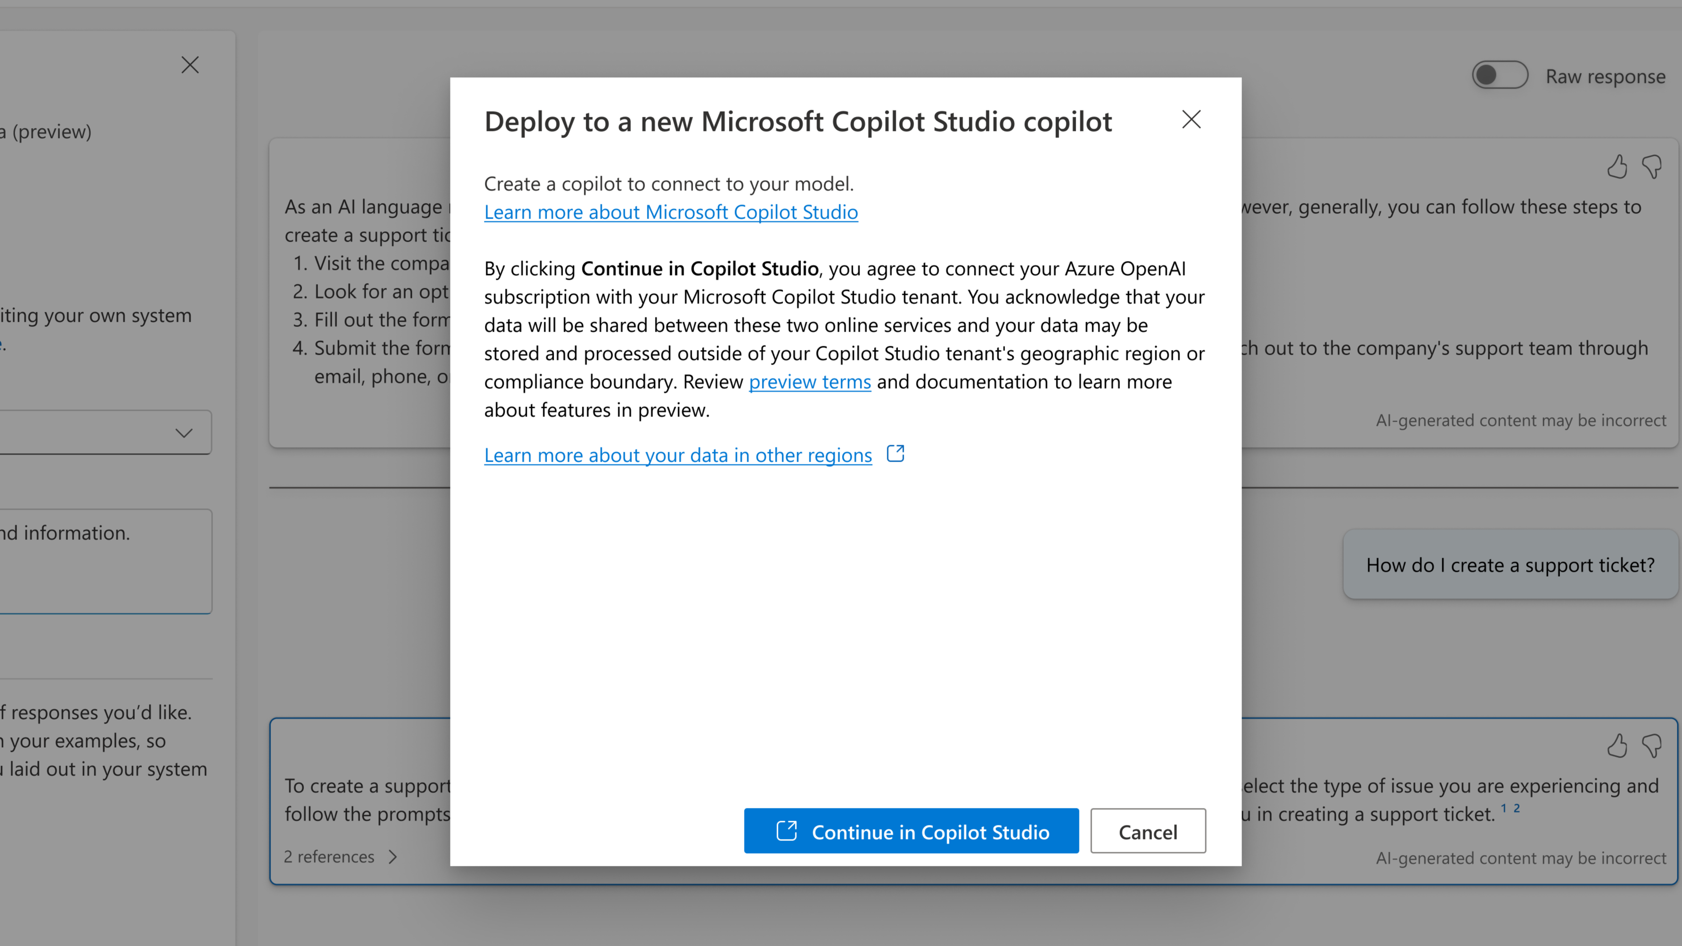
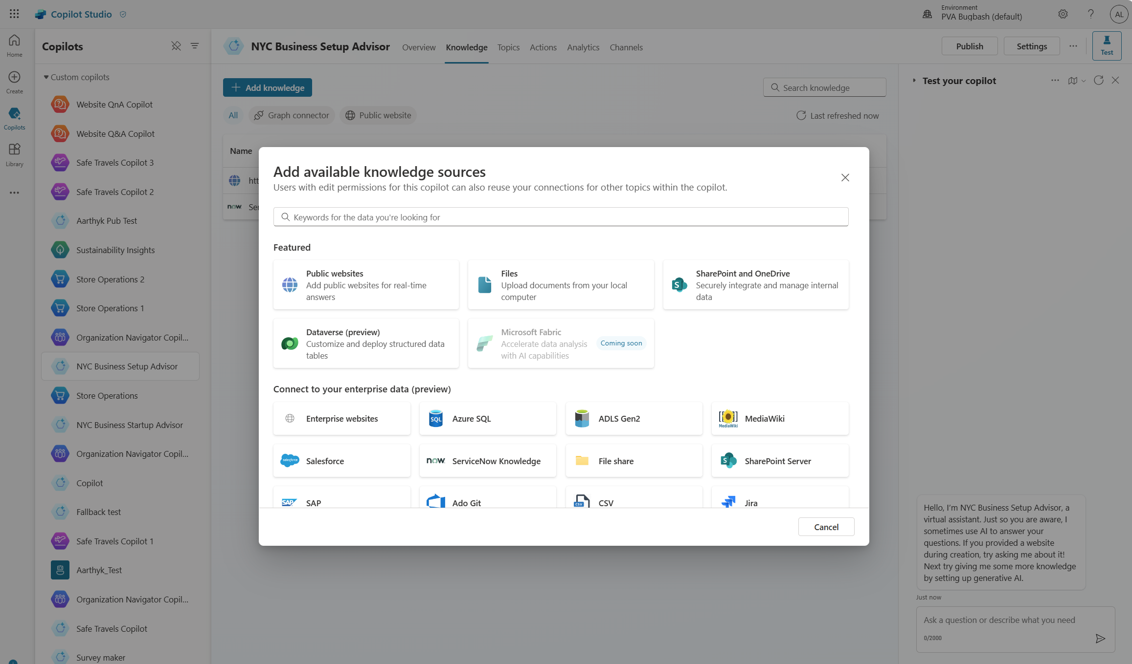
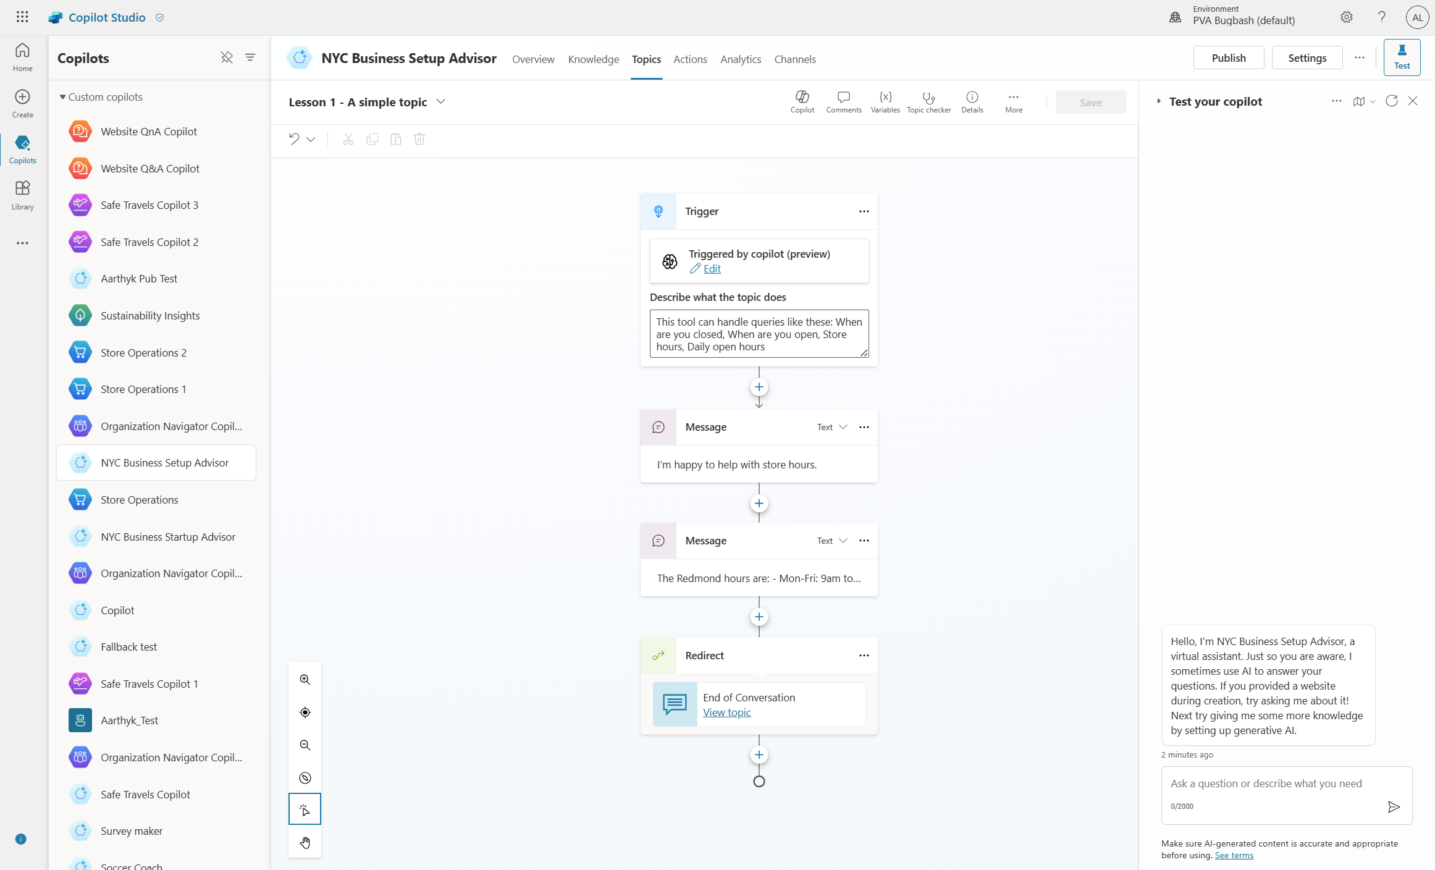
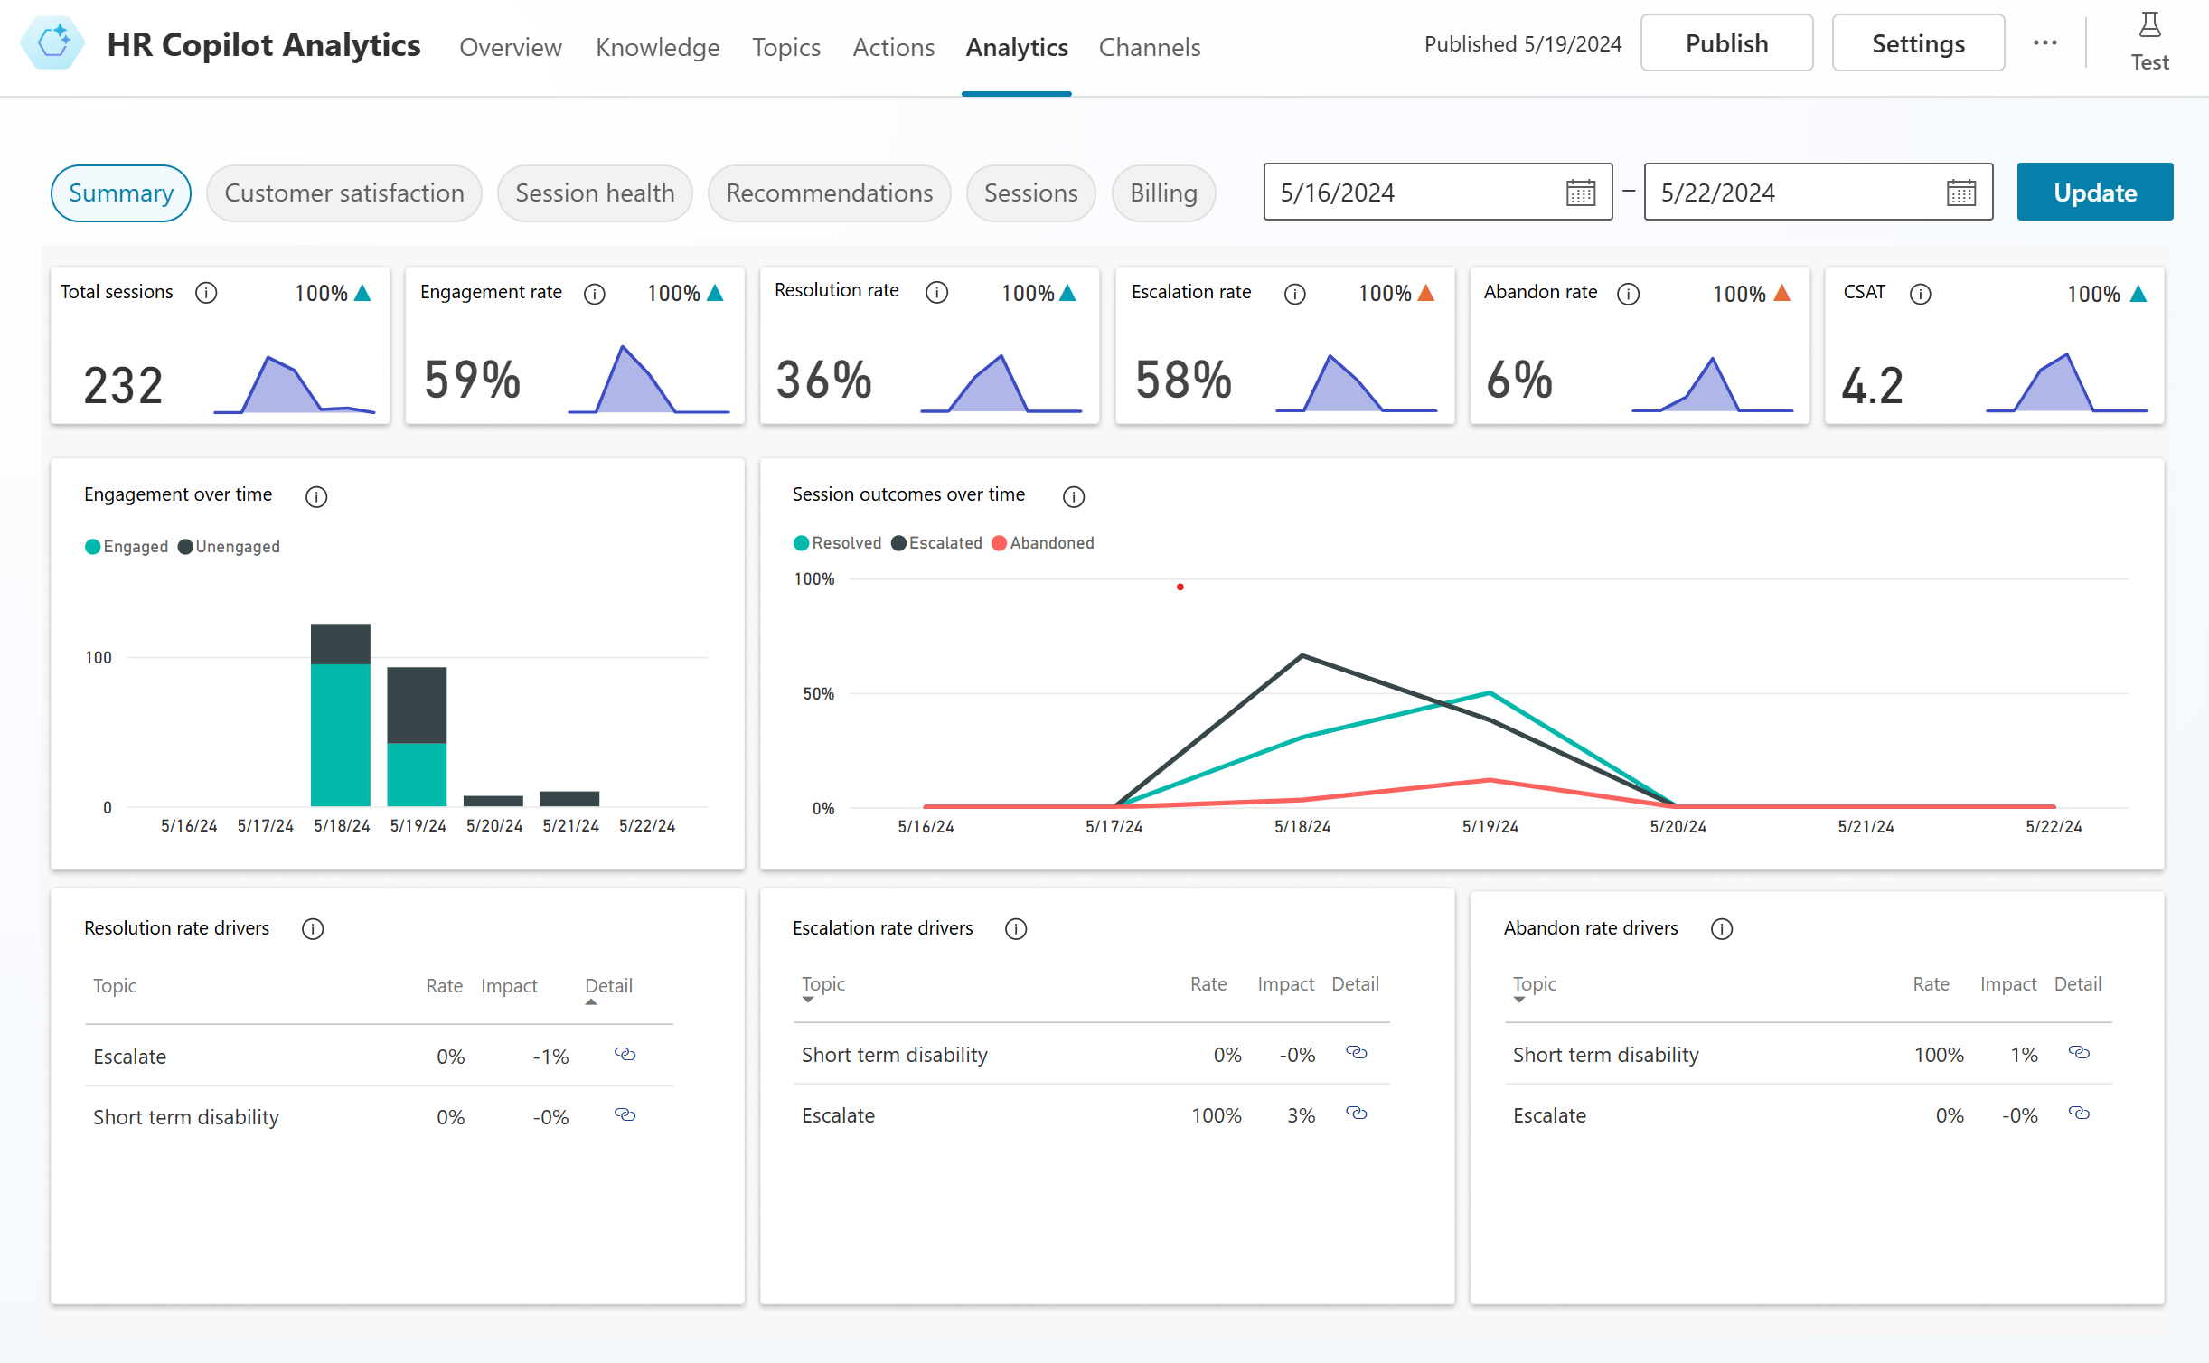
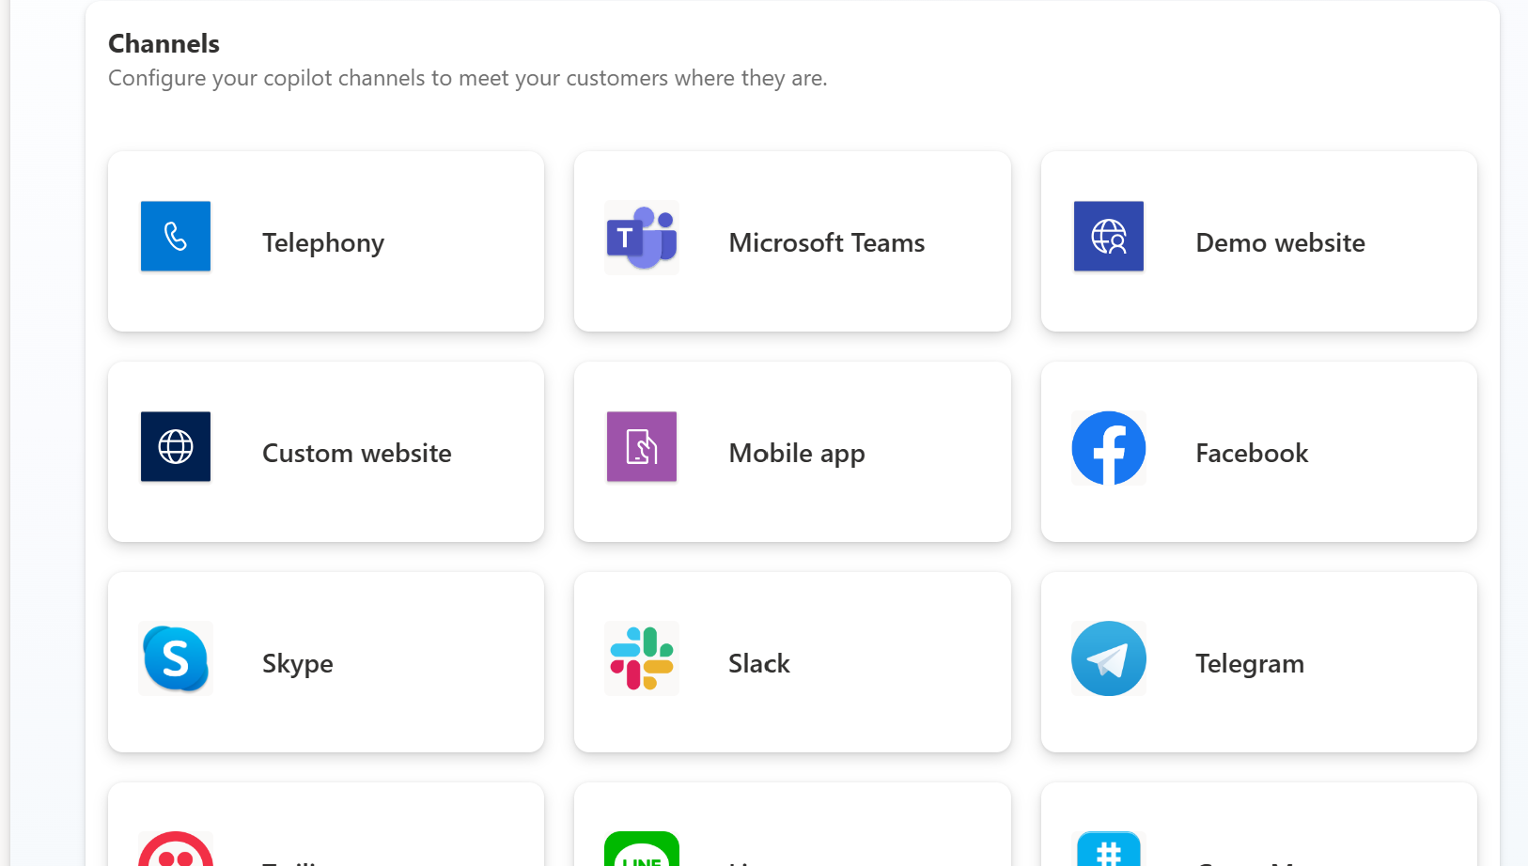
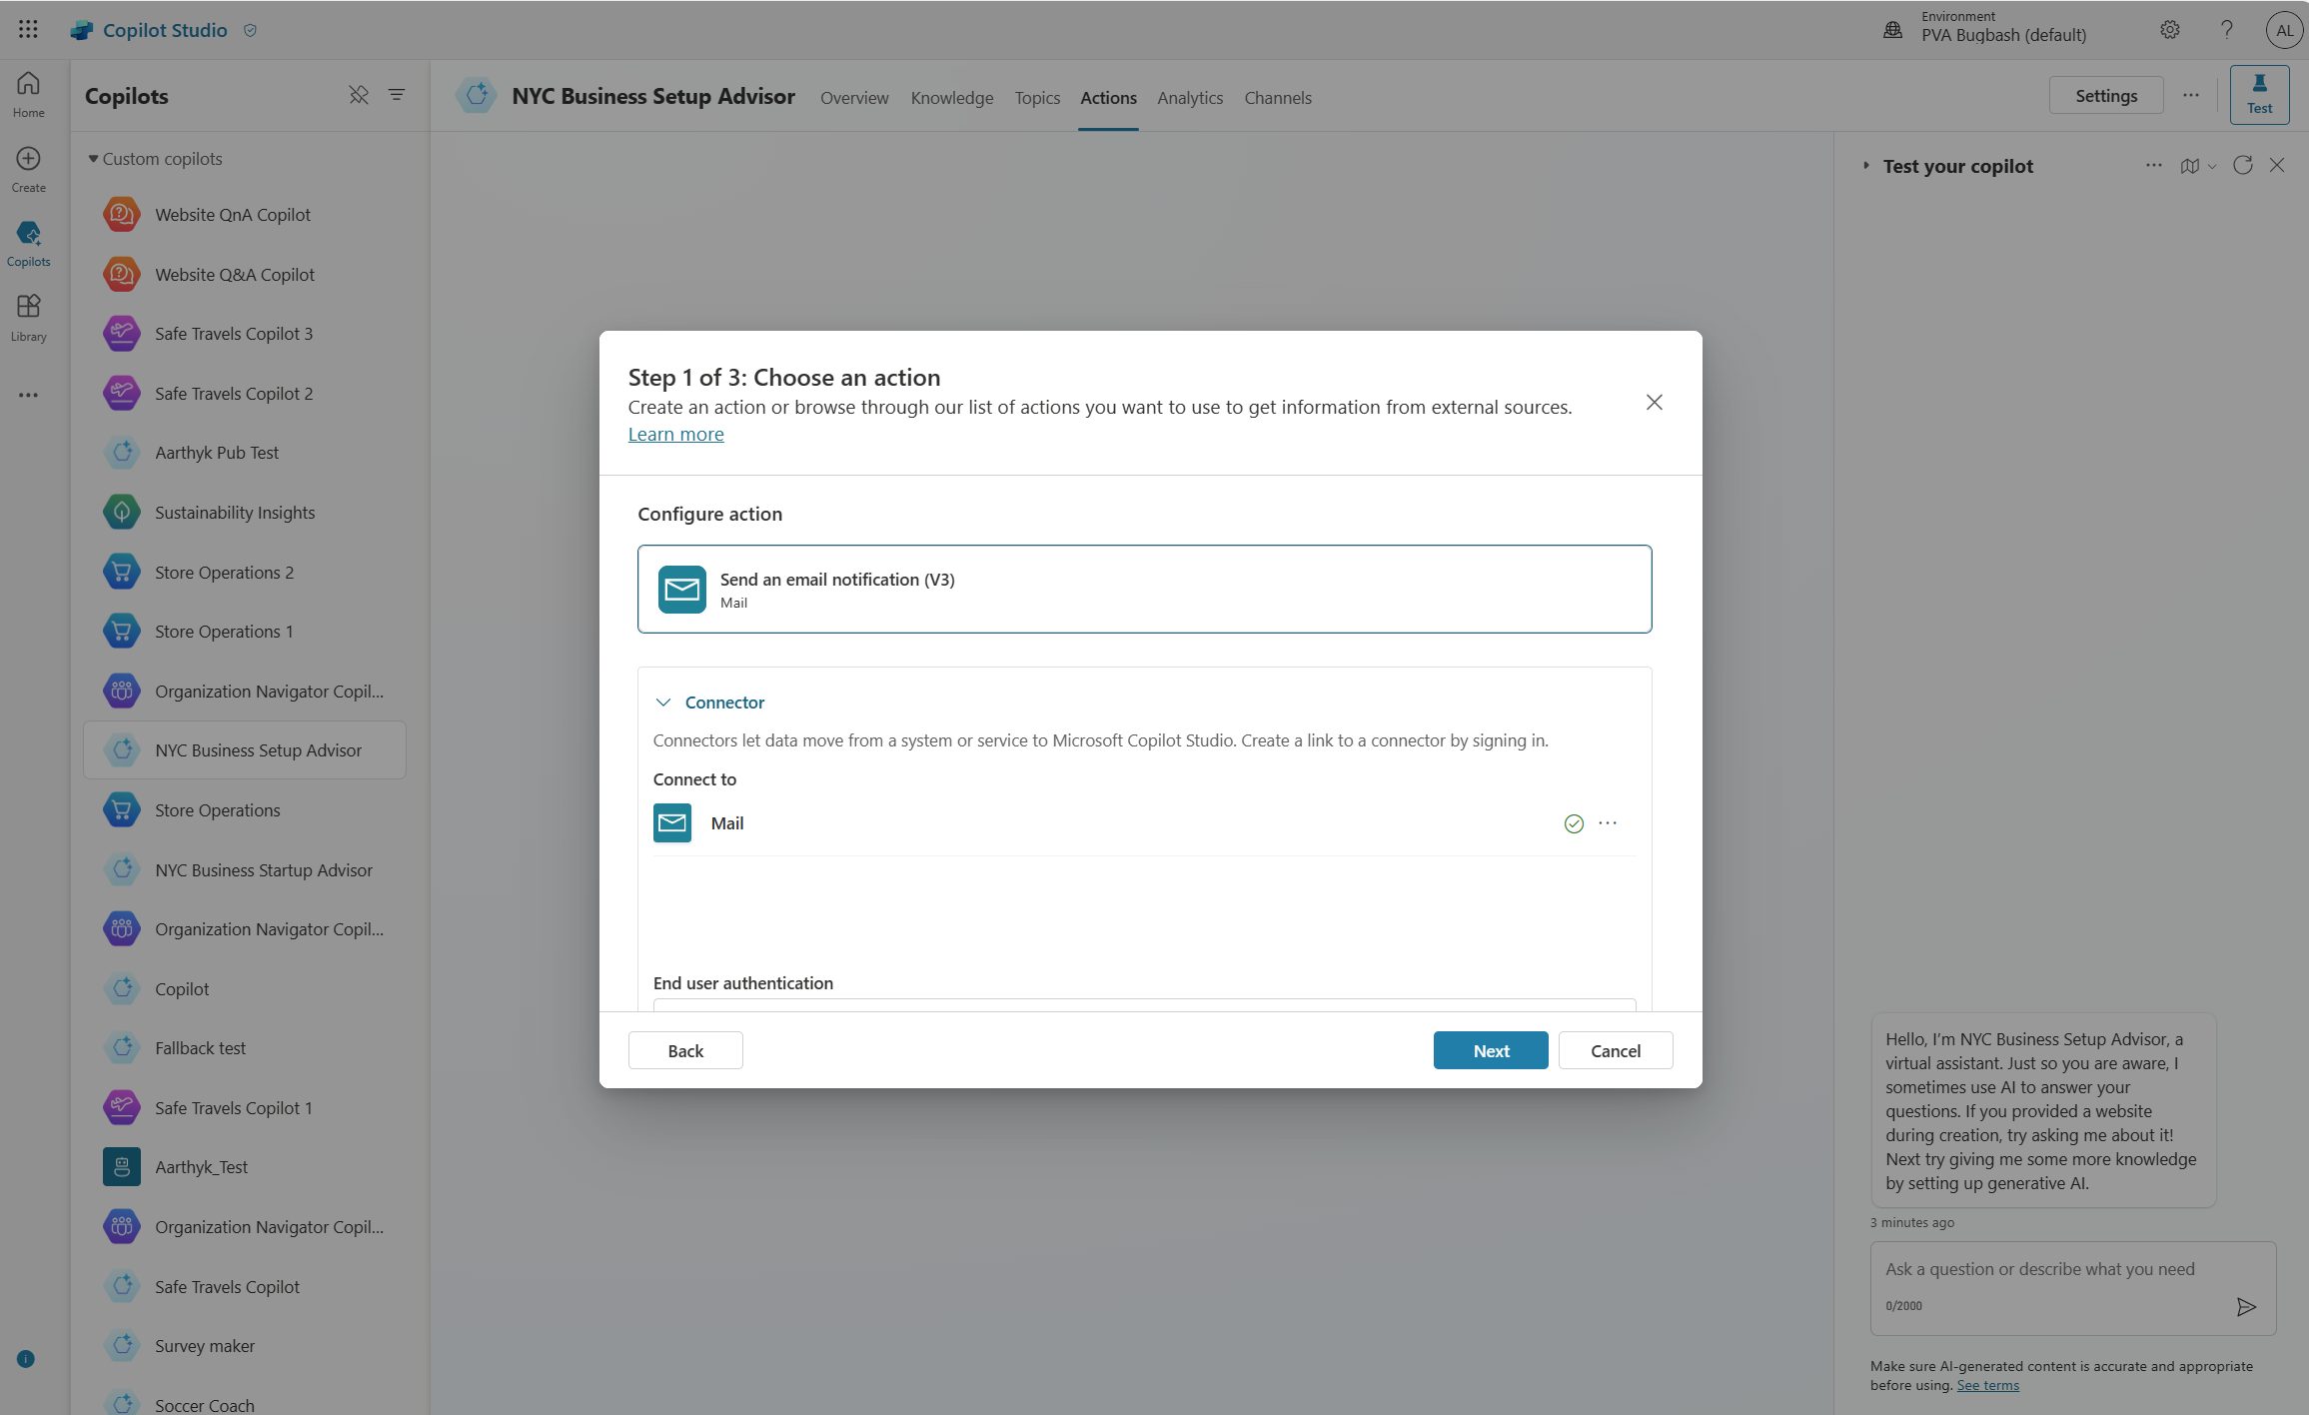
Copilot studio
Create, manage, publish and extend Copilots Live in minutes - all from one tool and E2E SaaS service
Chat over knowledge with Gen AI Get enterprise specific answers over your files, websites, internal shares, Dataverse, third party systems and more
Integrate with AI Services Integrate with Azure AI Studio, Azure Cog Services, Bot Framework and various other Microsoft conversational services
Build & Publish
Create specific topics Supplement generative responses with specific, curated topics where you want tight control. Build them easily with the powerful graphical studio
Monitor and Improve with rich out-of-the-box insights and analytics
Copilot Studio
Build actions & Plugins Create actions, plugins, use 1000s of pre-built connectors or Power Automate to call your backends and APIs
Publish to multiple channels, and go live instantly on the SaaS service or choose to extend Copilot for Microsoft 365 with your custom capabilities
Analyze & Improve
Notes:
Marius

Slide 10


Copilot Studio
Copilot Studio
message capacity add-on
$200 per tenant/month
Tenant-wide capacity license sold in capacity packs.
1 capacity pack = 25,000 messages/month
Offer Details
Gen AI: AI-enabled conversations
Copilot in Microsoft Copilot Studio: Create and iterate on chatbot topics using expanded natural language capabilities
Power Automate for Microsoft Copilot Studio: Cloud flows – Create automated, instant and scheduled flows within context of Microsoft Copilot Studio bots
Connectors: Standard, Premium and Custom connectors
Dataverse for Microsoft Copilot Studio: Dataverse Default Capacity
5 GB Database Capacity
20 GB File Capacity
2 GB Log Capacity
All pricing subject to change, please consult price list for actual pricing.

Slide 11
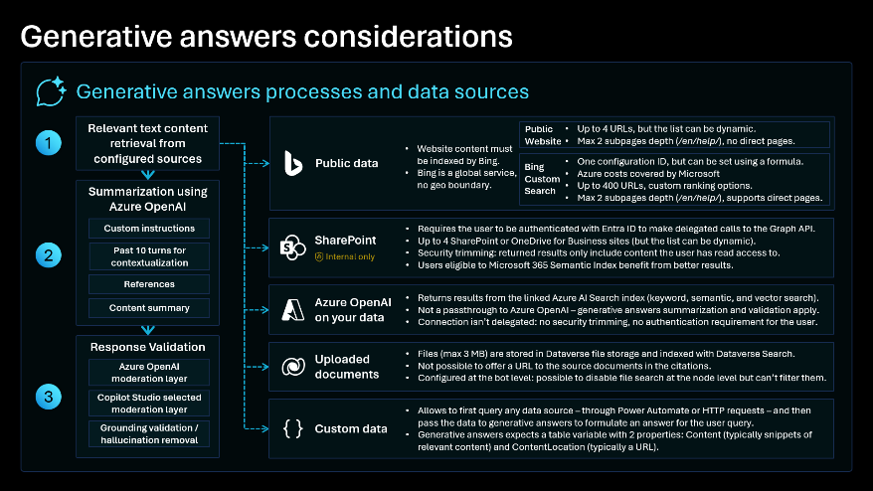
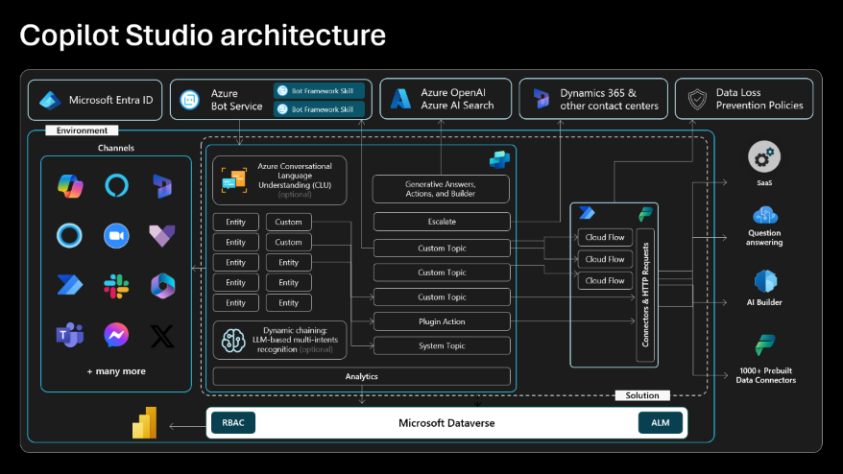
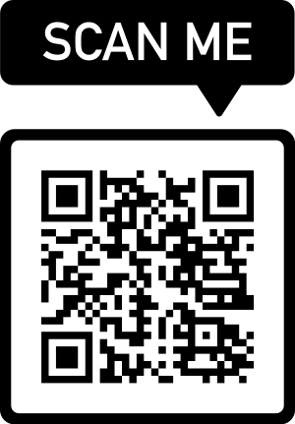
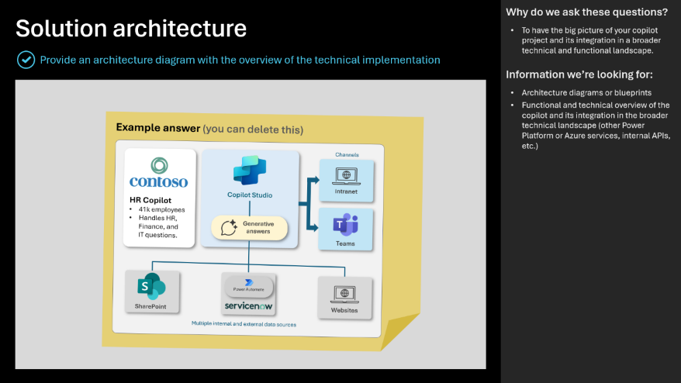
Copilot Studio Implementation Guide
The Copilot Studio implementation guide provides a framework to do a 360-degree review of a copilot or bot project.
Through probing questions, it highlights potential risks and gaps, aims at aligning the project with the product roadmap, and shares guidance, best practices and reference architecture examples.
aka.ms/CopilotStudioImplementationGuide

Slide 12
Get Started

Slide 13
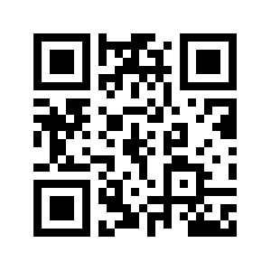
Go to aka.ms/PPCCMCSWorkshop
THEN:
Download and unzip the lab files locally.
Using the provided credentials, log in aka.ms/CopilotStudioStart
SCAN ME

Slide 14
Important lab instructions
Follow the labs most lab content is dependent on previous labs.
If you want to deviate from the labs and test your own scenarios, this is fine, but please do complete the labs first, and create your own separate custom copilot for your own scenarios and exploration after you’ve completed the labs.
Using a Mac? Use Chrome or Edge as there is known issue being fixed.
Trouble copy-pasting the content from PDFs? Use Word versions.

Slide 15
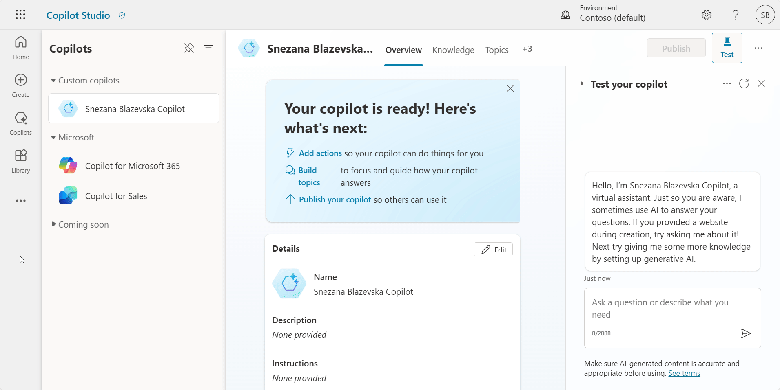
Productivity tip #1: Unpin the Copilots pane

Slide 16
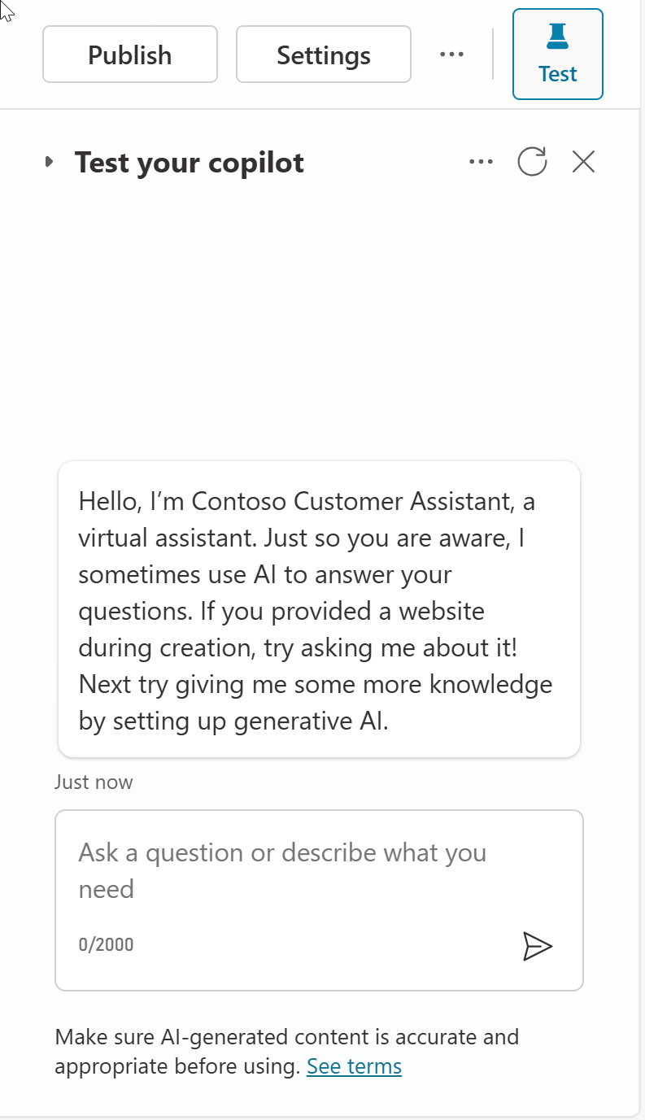
Productivity tip #2: Refresh the conversation between tests

Slide 17
Lab 01: Create your first copilot in Microsoft Copilot Studio

Slide 18
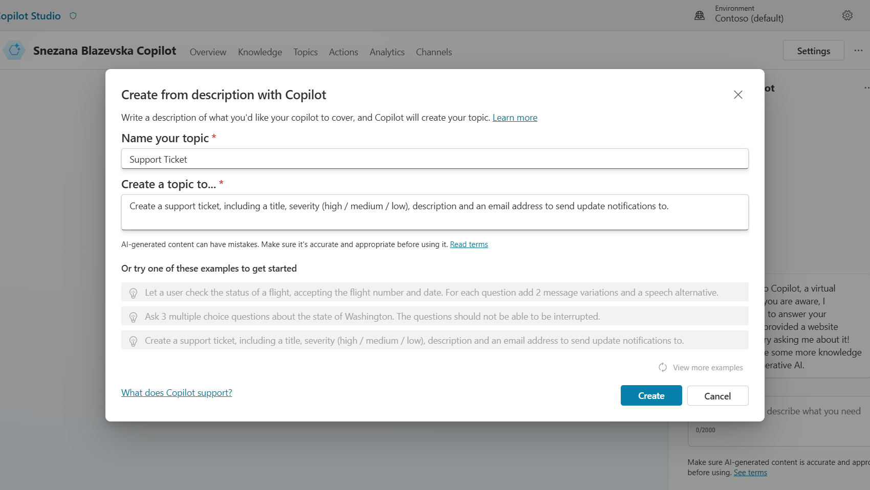
Copilot for Copilot Studio
AI assistance in building topics, designing and modifying the copilot all through natural language
Assisted authoring for:
Topic creation
Topic iteration
Response generation
Adaptive Card generation
Topic improvement suggestions
Suggested trigger phrases, topic names, topic descriptions
Transcript generation
Copilot creation
Topic suggestions
Azure bots take months to author
Copilots took days to author
Prompt-authored copilots will take hours or even minutes to author.
Generally Available

Slide 19
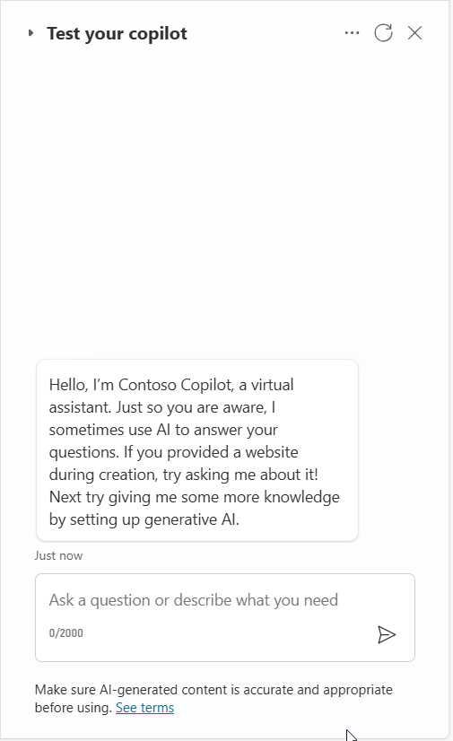
Demo Lab 1

Slide 20
Lab time!
Lab 01 [40] minutes

Slide 21
Lab 02: Authoring 101

Slide 22
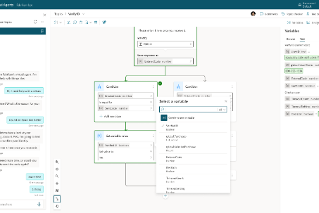
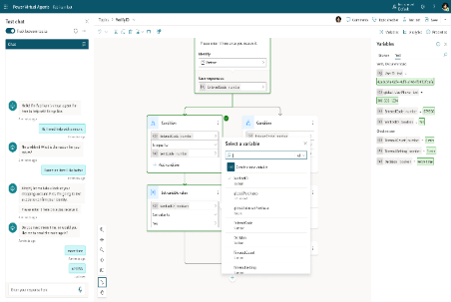
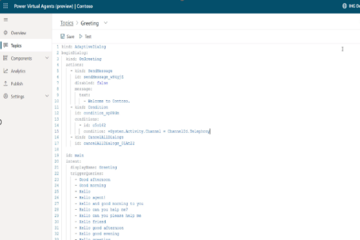
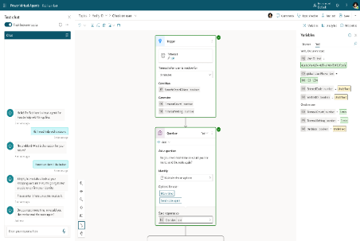
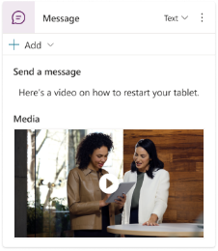
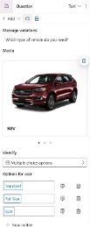
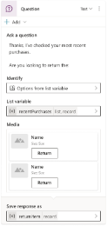




Copilot Studio authoring canvas
Rich Responses
Power Fx-based variables system
Code side-by-side
Event-driven & contextual triggering
Productivity
New features including:
Power Fx integrated formula editor for variable management
List / Record type support
Condition nodes with Power Fx formula support
Iterate over a List with new Loop nodes (coming soon)
Move between a visual editor and code
Share and re-use topic logic between developers and bots
Trigger an event that can interrupt Dialogs if it detects a certain value has been received
Add more nuanced responses to a message when the bot runs into an issue.
Bots can stay within context when a user asks for additional help or more details
Cut, Copy, Paste
Multi-node selection
Enhanced topic navigation
Adaptive Cards
Images
Videos
Quick Replies

Slide 23
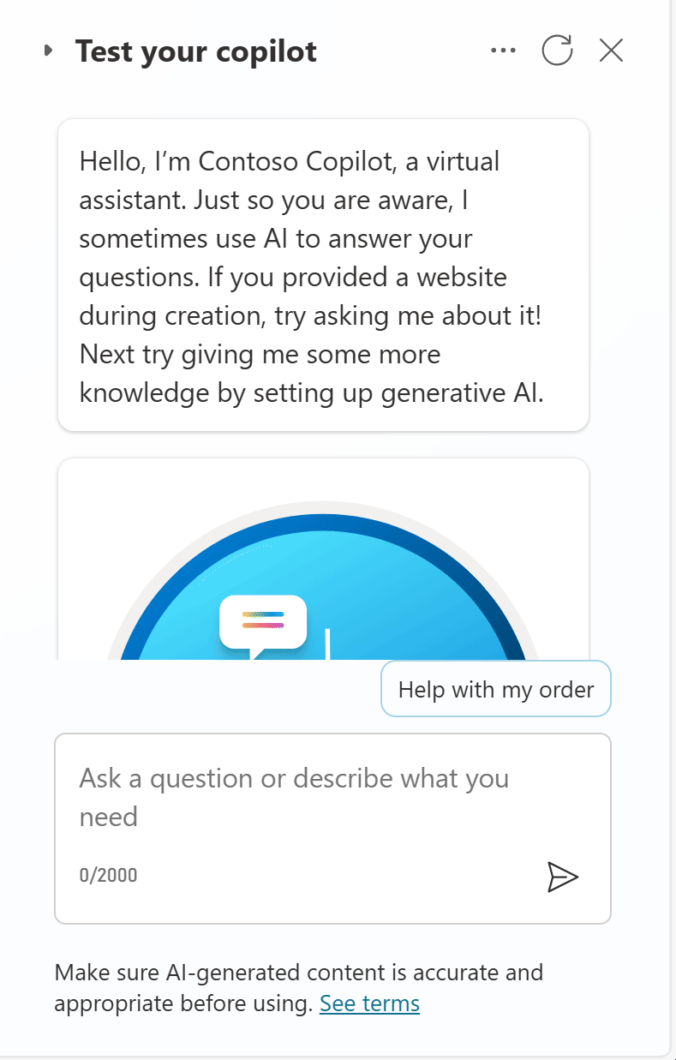
Demo Lab 2

Slide 24
Lab time!
Lab 02 [60] minutes

Slide 25







Disambiguation with topic design
Natural Language Understanding Trigger phrases | “Trigger Phrases” Topics Triggered from trigger phrases or redirects | Reusable, Bite-Size, Topics Explicitly called by topics
Topic: Card
Topic: Debit Card
Issue with my card
Block card
I need to block my credit card
Need help blocking debit card
Unblock card
Need to unblock credit card
How to unblock my debit card
Question: Debit/Credit
…
Question: Block/Unblock
Condition
Topic: Credit Card
Debit
Credit
…
End of Conversation
Topic: End of Conversation
Topic: Location
…
Find my nearest bank
Check branch location
Find a bank
Find me your nearest location
Banks near me
Question: Location
Location
Topic: Location Check
Message
…
End of Conversation

Slide 26



Natural language understanding
Standard NLU model
Custom Azure CLU model
Generative orchestration
Default, out-of-the-box, model that comes pre-trained, with many predefined entity types.
Configuration is done by adding trigger phrases and custom entities (either closed lists with values and synonyms, or regular expressions).
Supports additional languages, with native models.
Allows to further customize the intent triggering model for better intent recognition or to address specific industry requirements.
Allows for complex entity extraction (e.g., of the same type).
Entity extraction can also leverage Copilot Studio standard NLU.
Uses a GPT large language model.
Can handle multiple intents and chain topics and/or plugins.
Automatically generate questions for missing inputs and answers complex entities and questions from the conversation context.
Configuration is done by simply describing topics, plugin actions, and inputs/outputs.
Single intent recognition per query.
Cannot be extended.
Slot-filling multiple entities of the same type in the same query requires disambiguation for each (e.g., from and to cities)
Single intent recognition per query.
Configuration is done in Azure and involves additional costs.
Has its own service limits that need to be evaluated.
Azure CLU intents and Copilot Studio topics must be carefully kept in sync.
As it’s a generative AI feature, the licensing burn rate of messages is higher than in regular topic triggering.
Preview capability.

Slide 27
Handling unrecognized intents
Answering for unplanned user queries
1
3
The fallback topic gets triggered when Copilot Studio doesn't understand a user utterance and doesn’t have sufficient confidence to trigger any of the existing topics.
If knowledge sources are enabled on the copilot, the conversational boosting topic also triggers on the unknown intent event and triggers before the Fallback one.
2
4
There are many ways to handle unrecognized intents: using the AI’s own general knowledge, or knowledge sources to ground the answer in your own data sources and/or using the Fallback topic to integrate with any other systems. For example, question answering in Azure AI for Language allows you to offload large volumes of question-and-answer pairs. It also has a chitchat model to handle random questions to the copilot.
While it’s important to leverage the Conversational Boosting and Fallback capabilities, it’s also important to make sure that the core scenarios and topics of your copilots are property handled through custom topics and their outcomes defined (resolved, etc.).

Slide 28
Lab 03: Knowledge sources, AI knowledge, and custom instructions

Slide 29
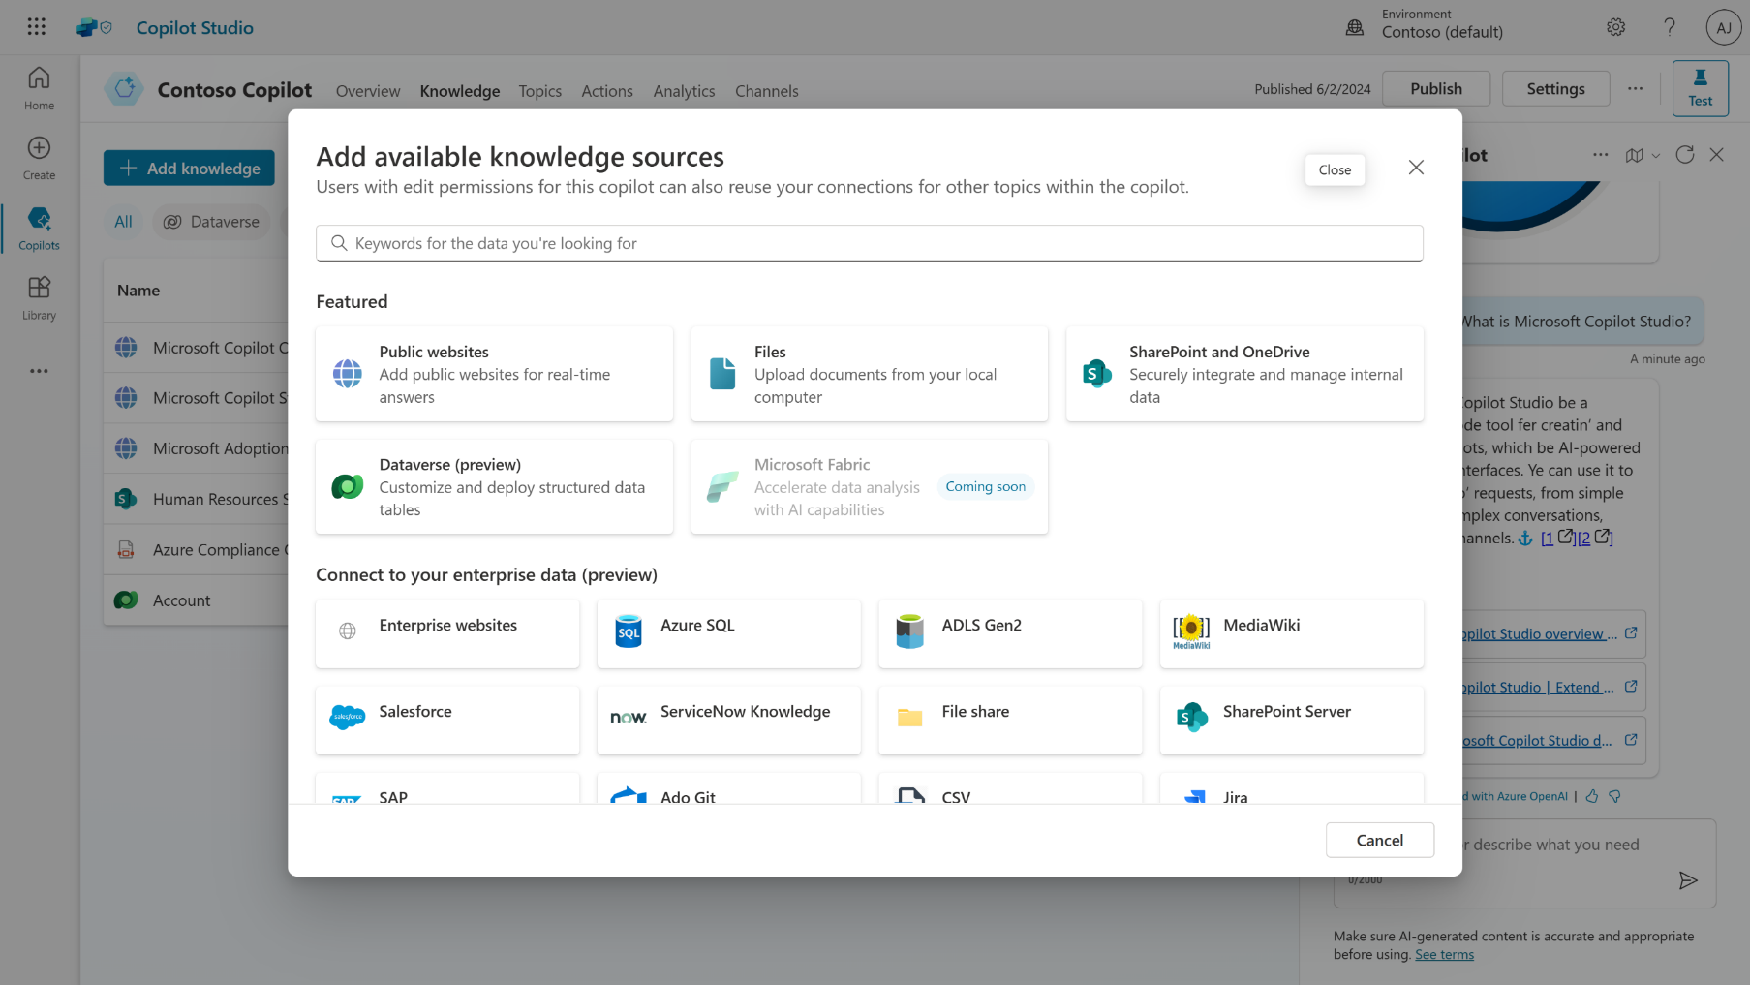
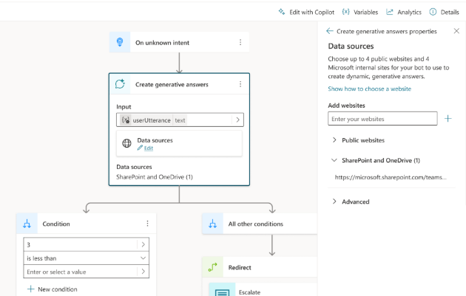
Knowledge sources
Enable multi-turn chat over your own internal and external knowledge sources and sites with generative answers
Copilots can answer thousands of questions out of the box in seconds
You can even pull data from an API or other backend system and enable generative chat over it
Try now at aka.ms/CopilotStudioDemo
Generally Available

Slide 30












Knowledge sources & Generative AI
Public data
Public Website
Max 2 subpages depth (/en/help/), no direct pages.
Websites must be indexed by Bing.
Bing being a global service, no regional boundary is possible.
One configuration ID, but it can be set using a formula.
Azure costs covered by Microsoft
Up to 400 URLs, custom ranking options.
Max 2 subpages depth (/en/help/), supports direct pages.
Bing Custom Search
1
Query rewriting
Optimizing the user question for search
SharePoint
Requires the user to be authenticated with Entra ID to make delegated calls to the Graph API.
Matching files (max 3 MB) are retrieved to get detailed snippets to summarize.
Security trimming: returned results only include content the user has read access to.
Users eligible to Microsoft 365 Semantic Index benefit from better results.
Last 10 turns are leveraged for contextualization
Internal only
2
Content retrieval
Azure OpenAI on your data preview
Returns results from the linked Azure AI Search index (keyword, semantic, and vector search).
Not a passthrough to Azure OpenAI – generative answers summarization and validation apply.
Connection isn’t delegated: no security trimming, no authentication requirement for the user.
Can index content from public URLs/web addresses (useful if regional boundary is required).
Querying each source
Top 3 results per source
Files
3
Summarization
Files (max 512 MB) are stored in Dataverse file storage and indexed with Dataverse Search.
Not possible to offer a URL to the source documents in the citations.
Documents are uploaded at the copilot level. Gen Answers node will search across all uploaded documents or none, when disabled at a node level.
Answer summarization from retrieved content
Citation generation
Requires a step to query the data source – using cloud flows, connectors, or HTTP requests.
Results are passed as inputs to the generative answers to summarize an answer for the query.
Input data needs to be in table format, with 3 properties: Content (typically snippets of relevant content) , ContentLocation (optional, typically a URL) and Title (optional).
Custom data
Answer personalization with custom instructions
Validation at each step
Dataverse preview
Moderation of harmful, malicious, uncompliant, or copyrighted answers
Dataverse tables (max 15).
Natural language queries are transformed in analytical queries (e.g., SQL) over structured data
Grounding validation and hallucination removal
Connect to additional enterprise knowledge sources that are indexed in Microsoft Graph.
Salesforce, ServiceNow, Confluence, Azure DevOps Wiki, etc.
Graph Connectors preview

Slide 31










Generative AI security and compliance considerations
The large language models (LLM) Copilot Studio depends upon are the foundation models trained by OpenAI.
Generative answers uses GPT-3.5 Turbo for summarization, but will soon be updated to GPT-4o as of Sep 2024.
Models are hosted on internal Azure OpenAI services, honoring the Microsoft Services Trust boundary.
Models are accessed and used following Microsoft Responsible AI principles and policies.
Custom instructions can be added to generative answers to influence format and filters.
Data storage and processing for Copilot Studio generative AI capabilities may result in data movement across regional boundaries. When local data storage and processing aren’t available in the region, environment settings are available to disable features requiring Azure OpenAI or Bing Search, preventing data movement.
Copilot Studio does not collect, nor provide any customer data, for use in the training of LLMs.
For operations purposes only, conversations are stored temporarily in a service-operated and secured store so that authorized Microsoft employees via Secure Access Workstations (SAWs) with Just-In-Time (JIT) access requests may respond to support requests. Access can be controlled through Customer Lockbox.
Generative AI capabilities log additional troubleshooting data, but only when the thumbs up or down reactions are used by the copilot author in the Copilot Studio test pane.
Given the existing control layers and to avoid further logging of customer data, Azure OpenAI abuse monitoring is disabled for Copilot Studio generative AI features.

Slide 32
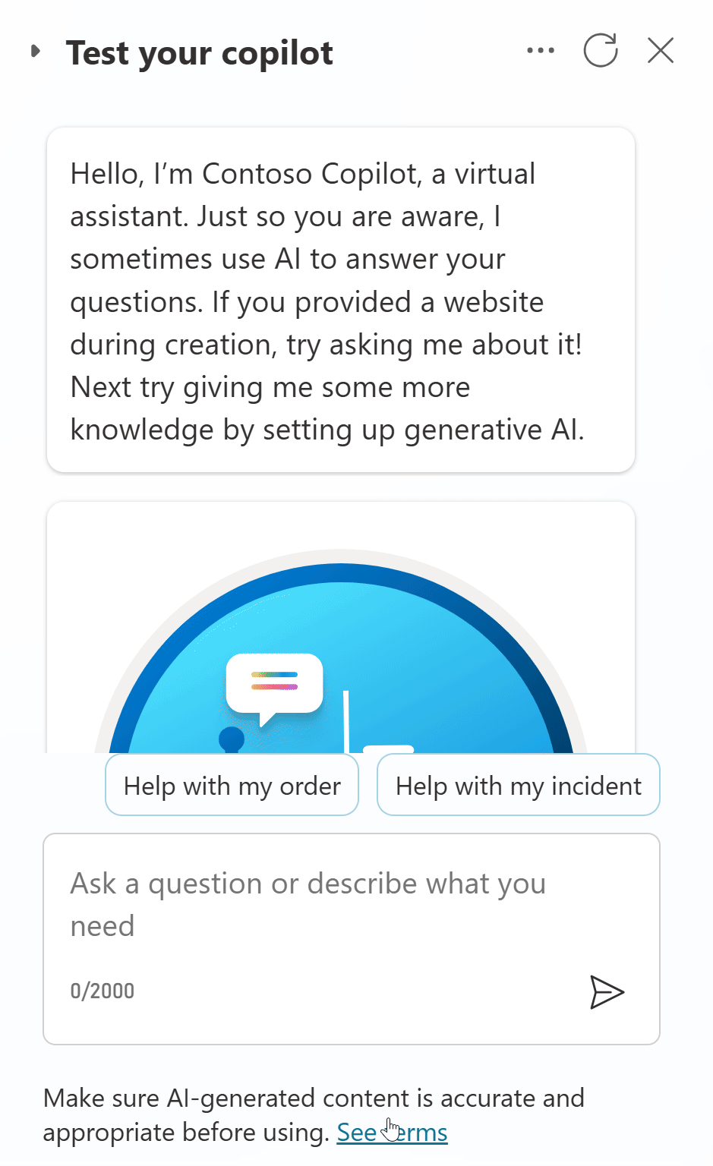
Demo Lab 3

Slide 33
Lab time!
Lab 03 [30] minutes

Slide 34
Lab 04: Build and call Power Automate cloud flows from your copilot

Slide 35



Integration patterns considerations
Power Automate Cloud flows
HTTP requests
& Connectors
Bot Framework
Skills
No-code / low-code.
Clear separation of integration and conversational logic.
Can be monitored separately.
Existing cloud flows can be updated to integrate with Copilot Studio.
No-code / low-code.
Faster runtime execution.
Can be monitored as part of Copilot Studio App Insights integration.
Can leverage variables, including environment variables and secrets.
Variables, conditions, parameters, etc. can use Power Fx formulas.
Parsing and error handling support.
Synchronous execution.
Support for private endpoints.
Existing Bot Framework investments can be reused.
Invocation and execution of the cloud flow can add latency.
If scale/performance are a concern, the higher-tier “Power Automate Process” plan can be evaluated.
“Power Automate Process” required for service principal ownership.
Need to return results within 100s.
Mixing conversational logic and integration logic, but integration topics can be isolated, as they can be configured for inputs and outputs.
Need to return results within 100s.
Pro-code (e.g., C#)
Runs in the Azure AI Bot Service.
Additional costs need to be covered by an Azure subscription.
ALM differs from Power Platform.

Slide 36
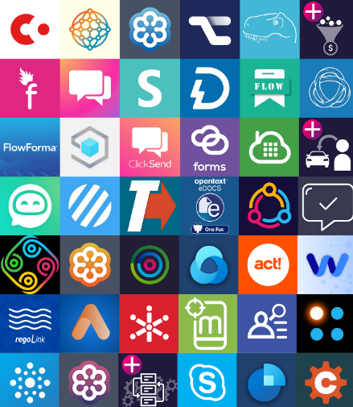


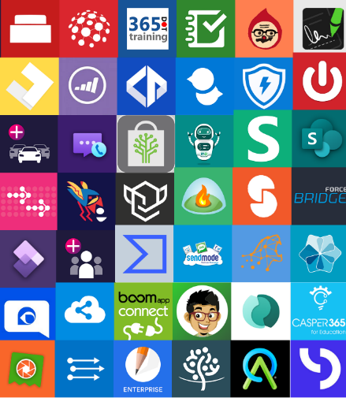



Power Platform Connectors
Multi-Channel
Power Platform, including Power Automate and Copilot Studio, offers great integration capabilities, with more 1,200 native connectors or ways to create your own custom connectors to your APIs.
For a good end-user experience, cloud flows, HTTP requests and connectors triggered from Copilot Studio must execute quickly so that the user doesn’t have to wait too long for the copilot to answer.
Website
Mobile
Teams
Facebook
Power Automate
Telephony
Email
Slack
Copilot
Studio
Direct line Speech
Many more
1200+ prebuilt data connectors

Slide 37
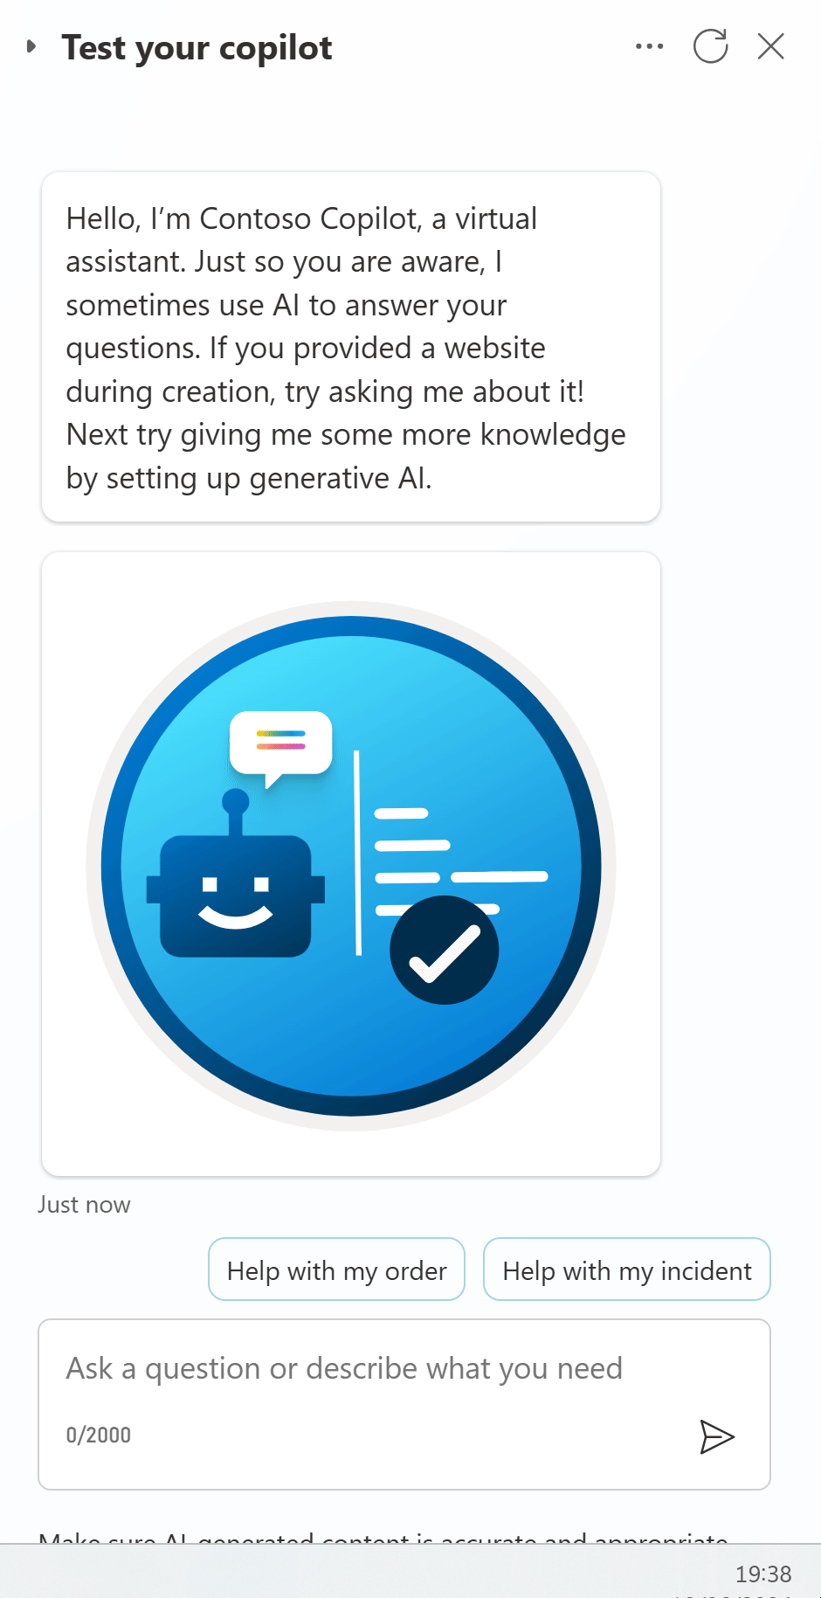
Demo Lab 4

Slide 38
Lab time!
Lab 04 [60] minutes

Slide 39
Lab 05: Invoke AI Builder prompts

Slide 40
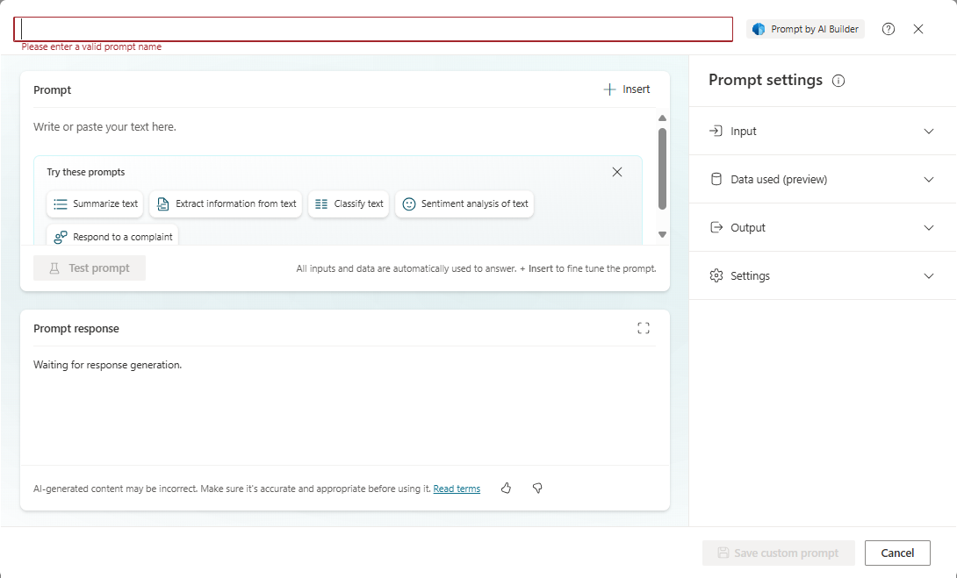
AI Prompts

Slide 41
Best practices for prompt instructions
Be specific: Custom instructions should be clear and specific, so the copilot knows exactly what to do. Avoid vague or ambiguous language that could lead to confusion or incorrect responses.
Use examples: Provide examples to illustrate your instructions and help the copilot understand your expectations. Examples help the copilot generate accurate and relevant responses.
Keep it simple: Avoid overloading your custom instructions with too many details or complex logic. Keep your instructions simple and straightforward so the copilot can process them effectively.
Give the copilot a way out: Give the copilot an alternative path for when it's unable to complete the assigned task. For example, when the user asks a question, you might include "respond with 'not found' if the answer isn't present." This alternative path helps the copilot avoid generating false responses.
Test and refine: It's important to test your custom instructions thoroughly to ensure they're working as intended. Make adjustments as needed to improve the accuracy and effectiveness of your copilot's responses.

Slide 42
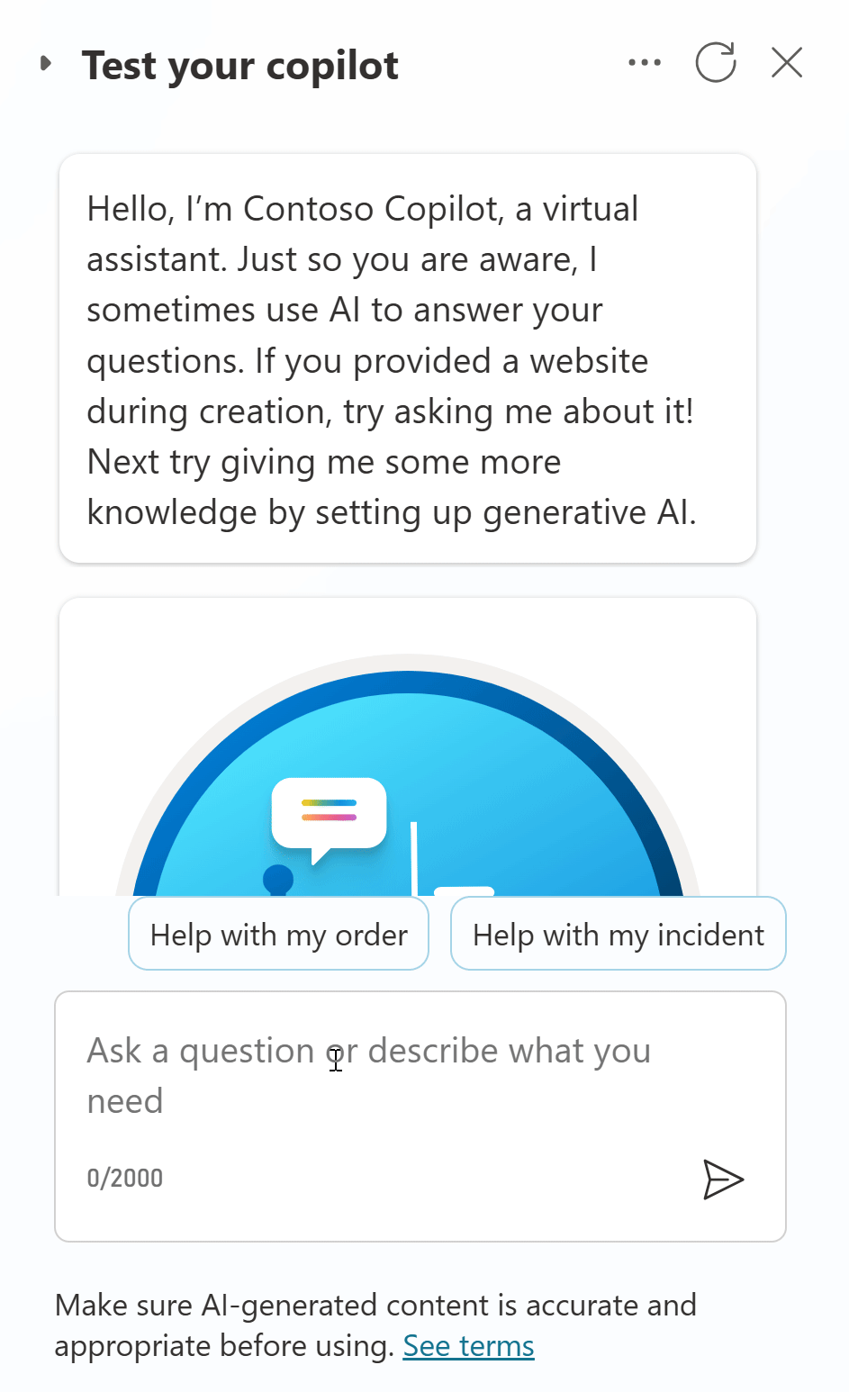
Demo Lab 5

Slide 43
Lab time!
Lab 05 [25] minutes

Slide 44
Lab 06: Make HTTP requests to connect to an API

Slide 45
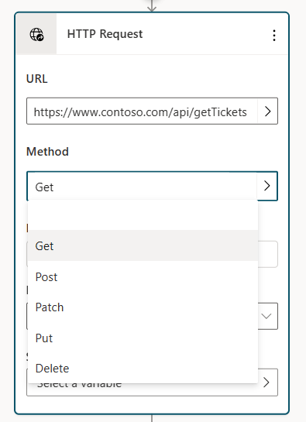
HTTP request
In Copilot Studio, you can extend an agent capabilities by calling external REST APIs using the HTTP request node.
This call can be helpful when you need to retrieve data from an external system.
You can use different methods and inject your own header and body.
The response can be parsed in JSON format following a sample schema.
The HTTP request node has multiple options for handling situations where the HTTP request might fail or return an error.

Slide 46
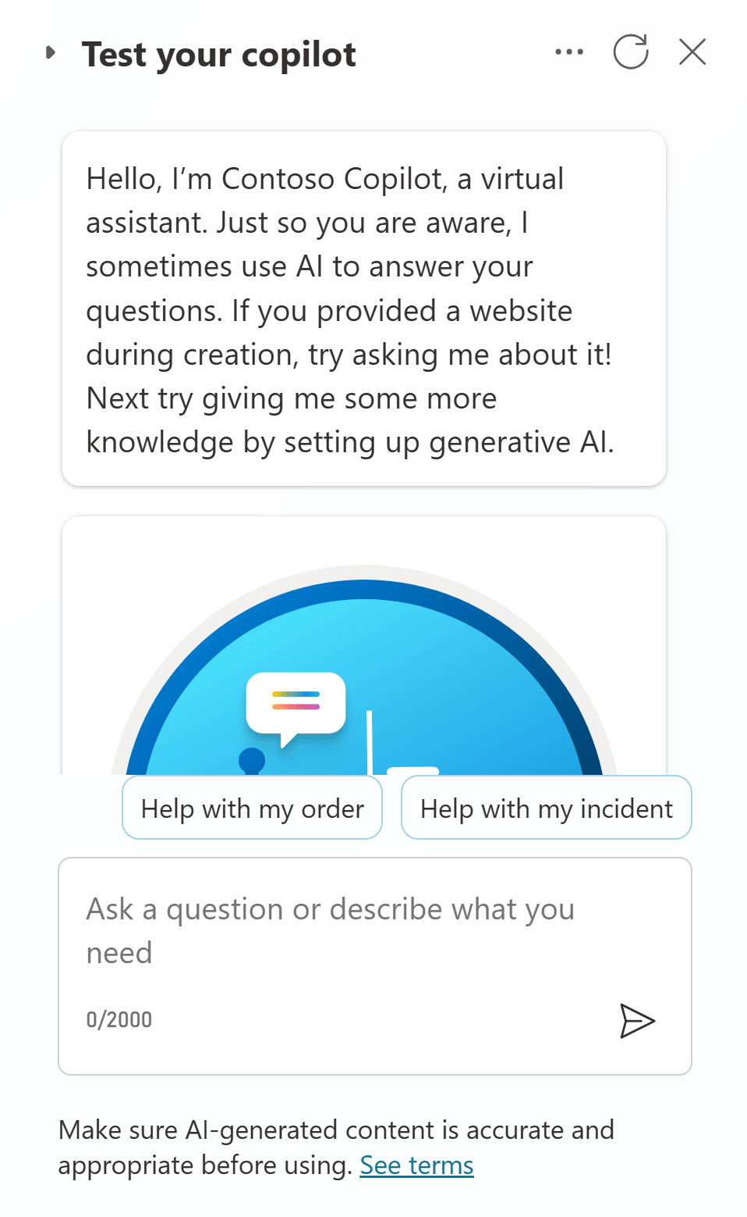
Demo Lab 6

Slide 47
Lab time!
Lab 06 [20] minutes

Slide 48
Lab 07: Use generative AI orchestration to interact with your connectors

Slide 49
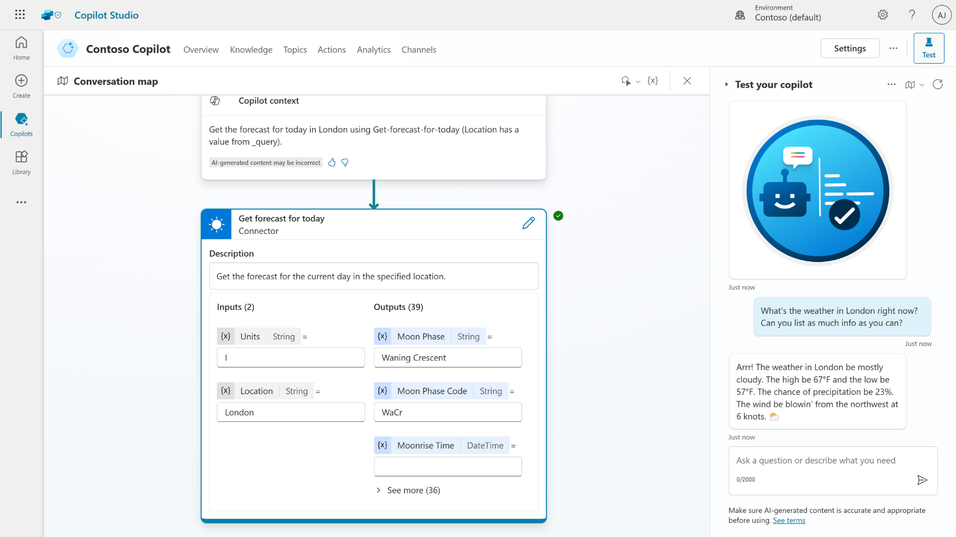
Generative AI orchestration
Test and trace feature to see it in action
Dynamically chains actions and topics together to produce actionable responses
Handle multi-intent queries that were not anticipated or built by the user
Automatically slot-fill further details to get the information needed for the task
Powered by the Azure OpenAI Service with LangChain concepts
Public Preview

Slide 50
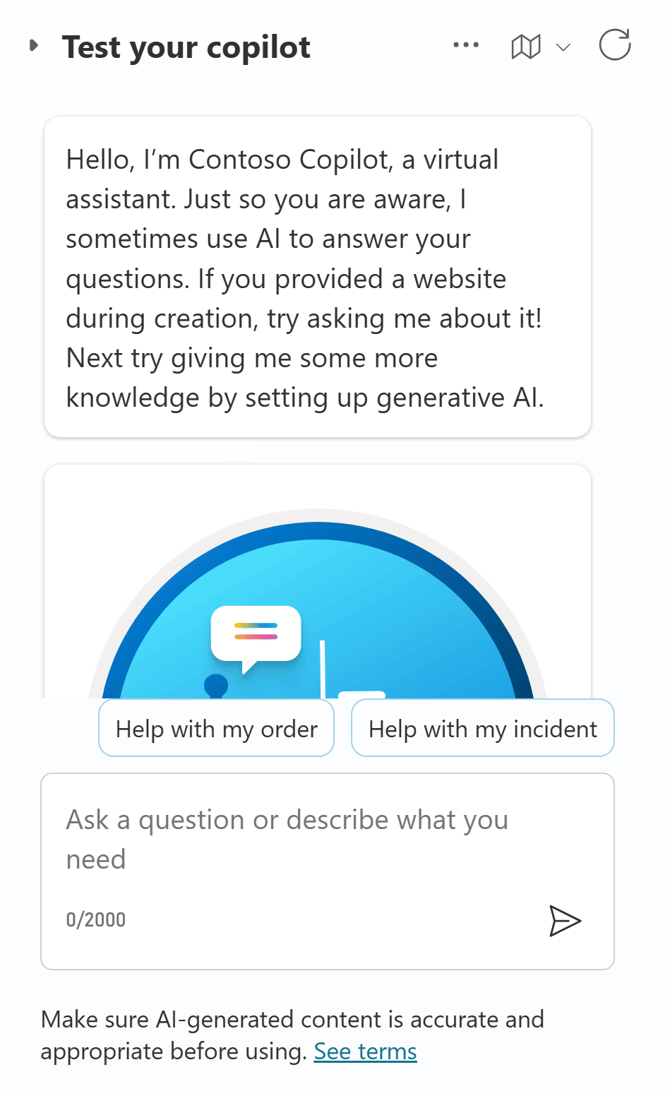
Demo Lab 7

Slide 51
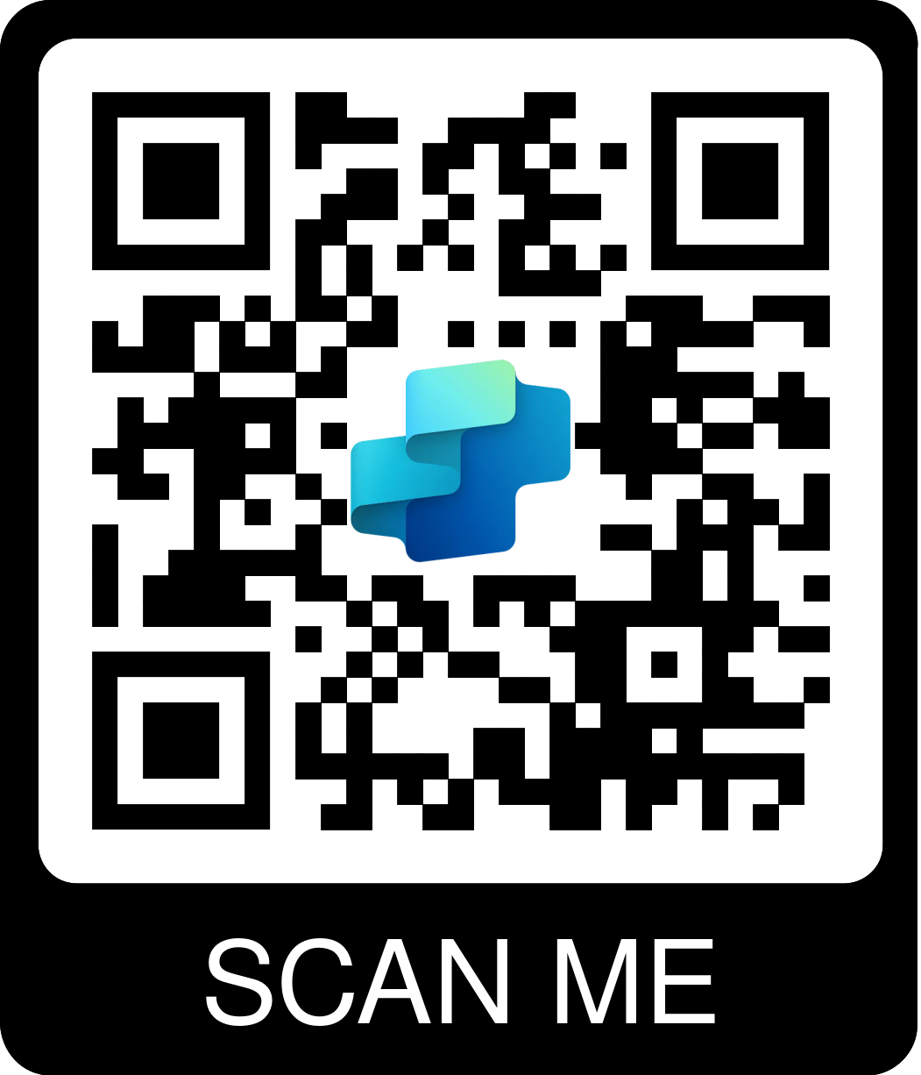
Lab time!
Lab 07 [20] minutes

Slide 52
Lab 08: Using topic inputs

Slide 53
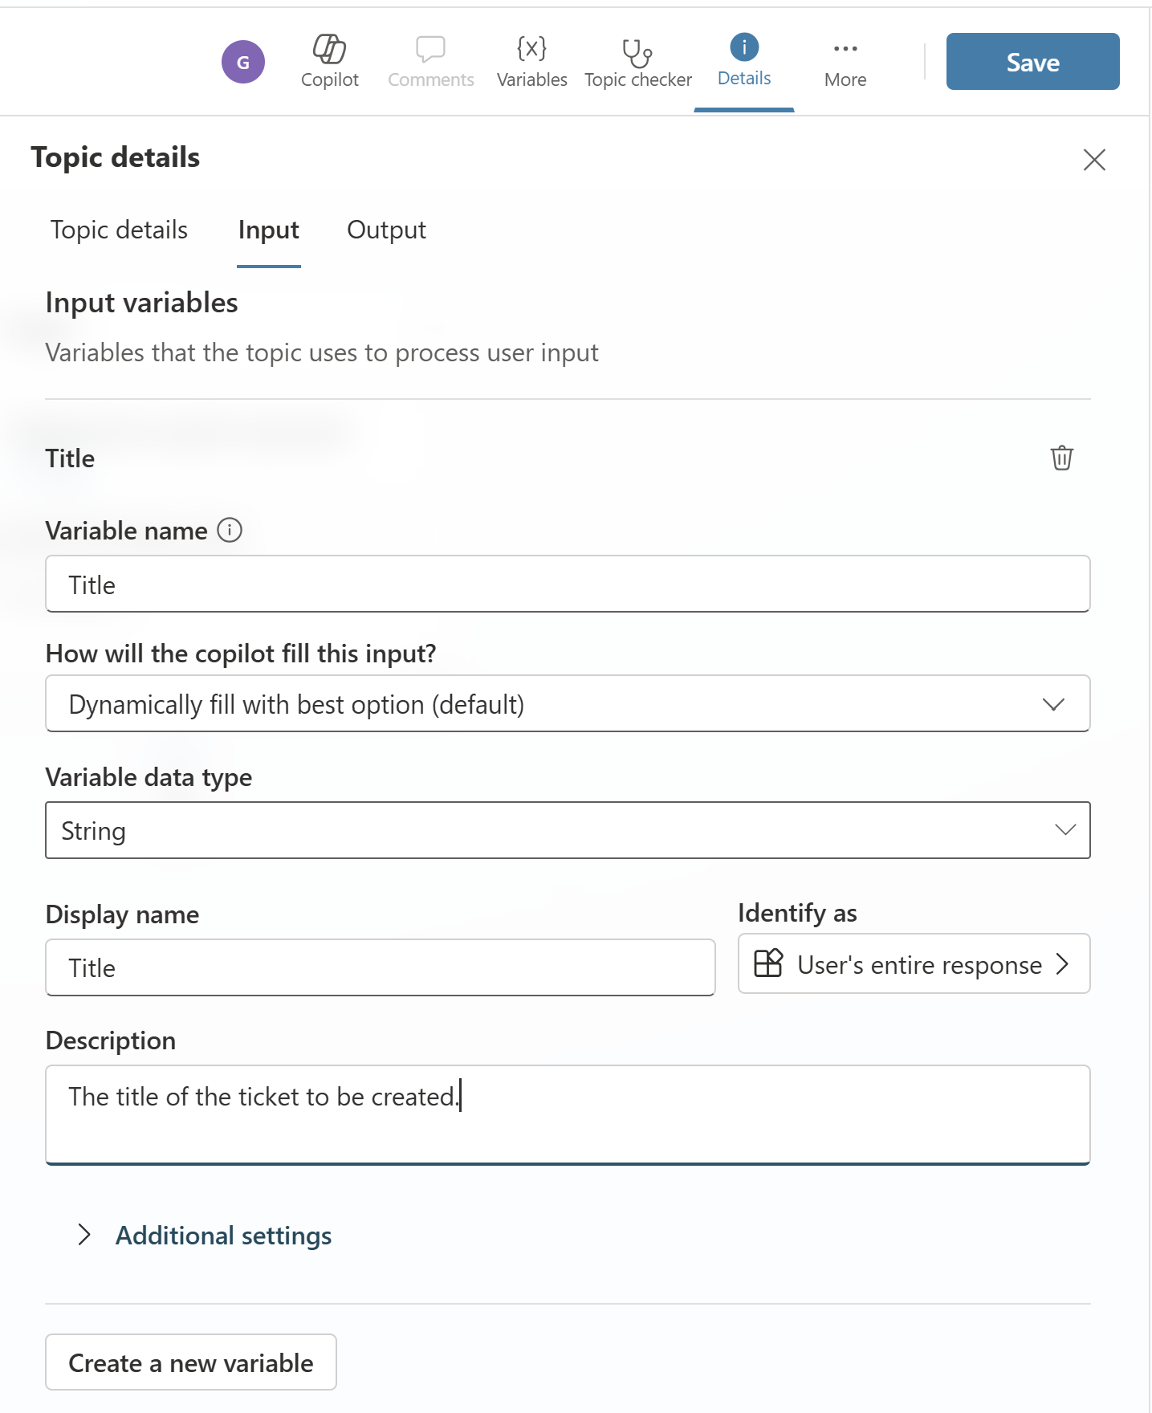
Topic inputs and outputs
Topics can have input and output parameters. When a topic redirects to another topic, you can use these parameters to pass information between topics.
If your copilot uses generative AI to decide how to respond to users, it can automatically fill inputs, before running the topic, by using conversation context or generate questions to collect values from the user's response.

Slide 54
Lab time!
https://aka.ms/CopilotStudioFeatureRequest
Lab 08 [15] minutes

Slide 55
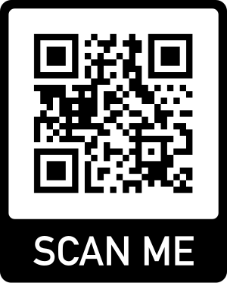
Q&A
SHARE YOUR FEEDBACK!
aka.ms/PPCC2024Workshop

Slide 56
Resources

Slide 57
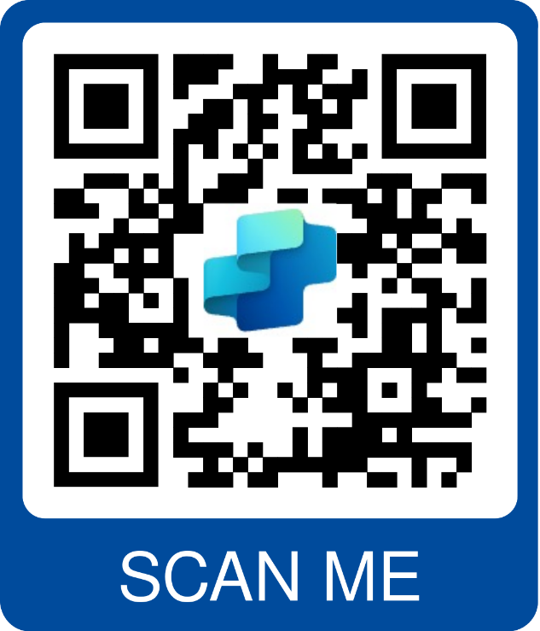
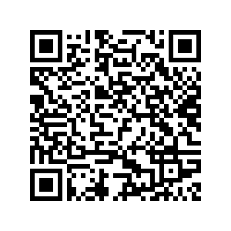

Resources
Copilot Studio trial | aka.ms/TryCopilotStudio
Copilot Studio website | aka.ms/CopilotStudio
Official Blog | aka.ms/CopilotStudioBlog
Copilot Studio Demo | aka.ms/CopilotStudioDemo
Copilot Studio Kit | aka.ms/CopilotStudioKit
Product documentation | aka.ms/CopilotStudioDocs
Product guidance | aka.ms/CopilotStudioGuidance
Implementation guide | aka.ms/CopilotStudioImplementationGuide
Community | aka.ms/CopilotStudioCommunity
Follow-up Session on 1/31

